Slide 1

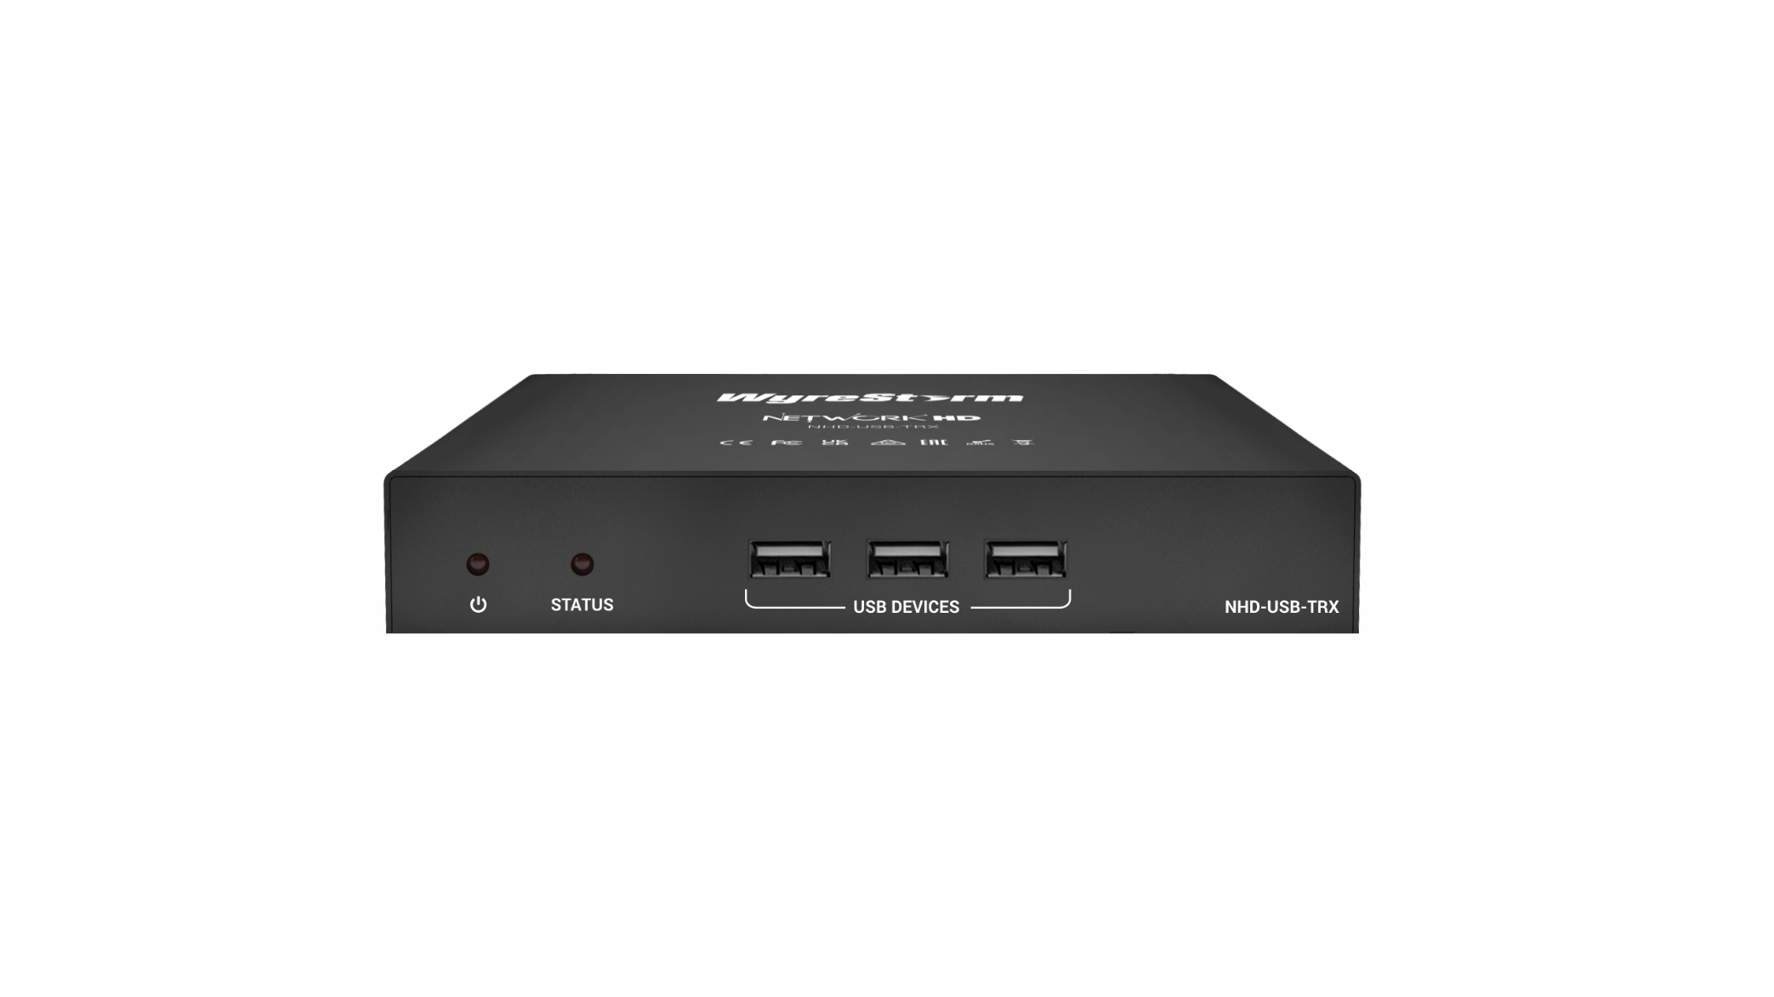

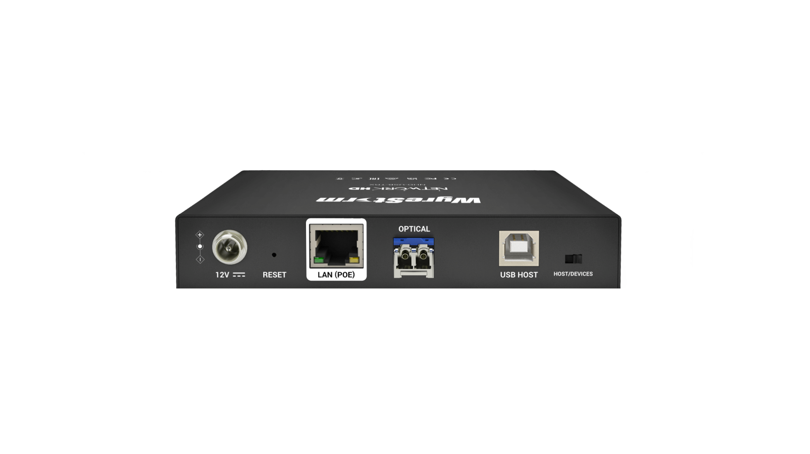

NHD-USB-TRX
Product Guide
USB 2.0 over IP
Award-Winning Audio-Visual Solutions Manufacturer
Notes:
1. 更新封面，不需要展示产品；

Slide 2

Contents
Product Overview
Interface & Specifications
Typical Connection & Applications
Competitor Analysis
Quick Installation Guide & Web UI Introduction
Q & A Session
Powerful · Reliable · Simple

Slide 3
Product Overview
Seamless Interoperability with NHD-500
Fully compatible with the NHD-500 series encoders and decoders, leveraging their built-in USB functionality.
Centralized control and management through the NHD-CTL-PRO controller for system-wide integration.
USB2.0 over IP
Delivers USB 2.0 over IP functionality, enabling one-to-one and one-to-many connections.
Supports a wide variety of USB 2.0 input devices, ensuring adaptability for diverse application scenarios.
USB3.2 Gen2 Local Hub (HOST Mode)
Features a USB 3.2 Gen2 local USB hub with up to 10Gbps data transfer speed for devices requiring fast data rates.
PoE+ Technology
Integrated PoE+ (Power over Ethernet) allows a single cable for both network connectivity and power delivery.
Provides sufficient power for high-current USB devices, eliminating the need for additional power adapters.
Single SKU for HOST and DEVICES Mode
Easily switch between HOST mode and DEVICE mode via DIP switch or NHD-CTL-PRO controller.
Simplified SKU management for greater deployment flexibility.
Powerful · Reliable · Simple

Slide 4
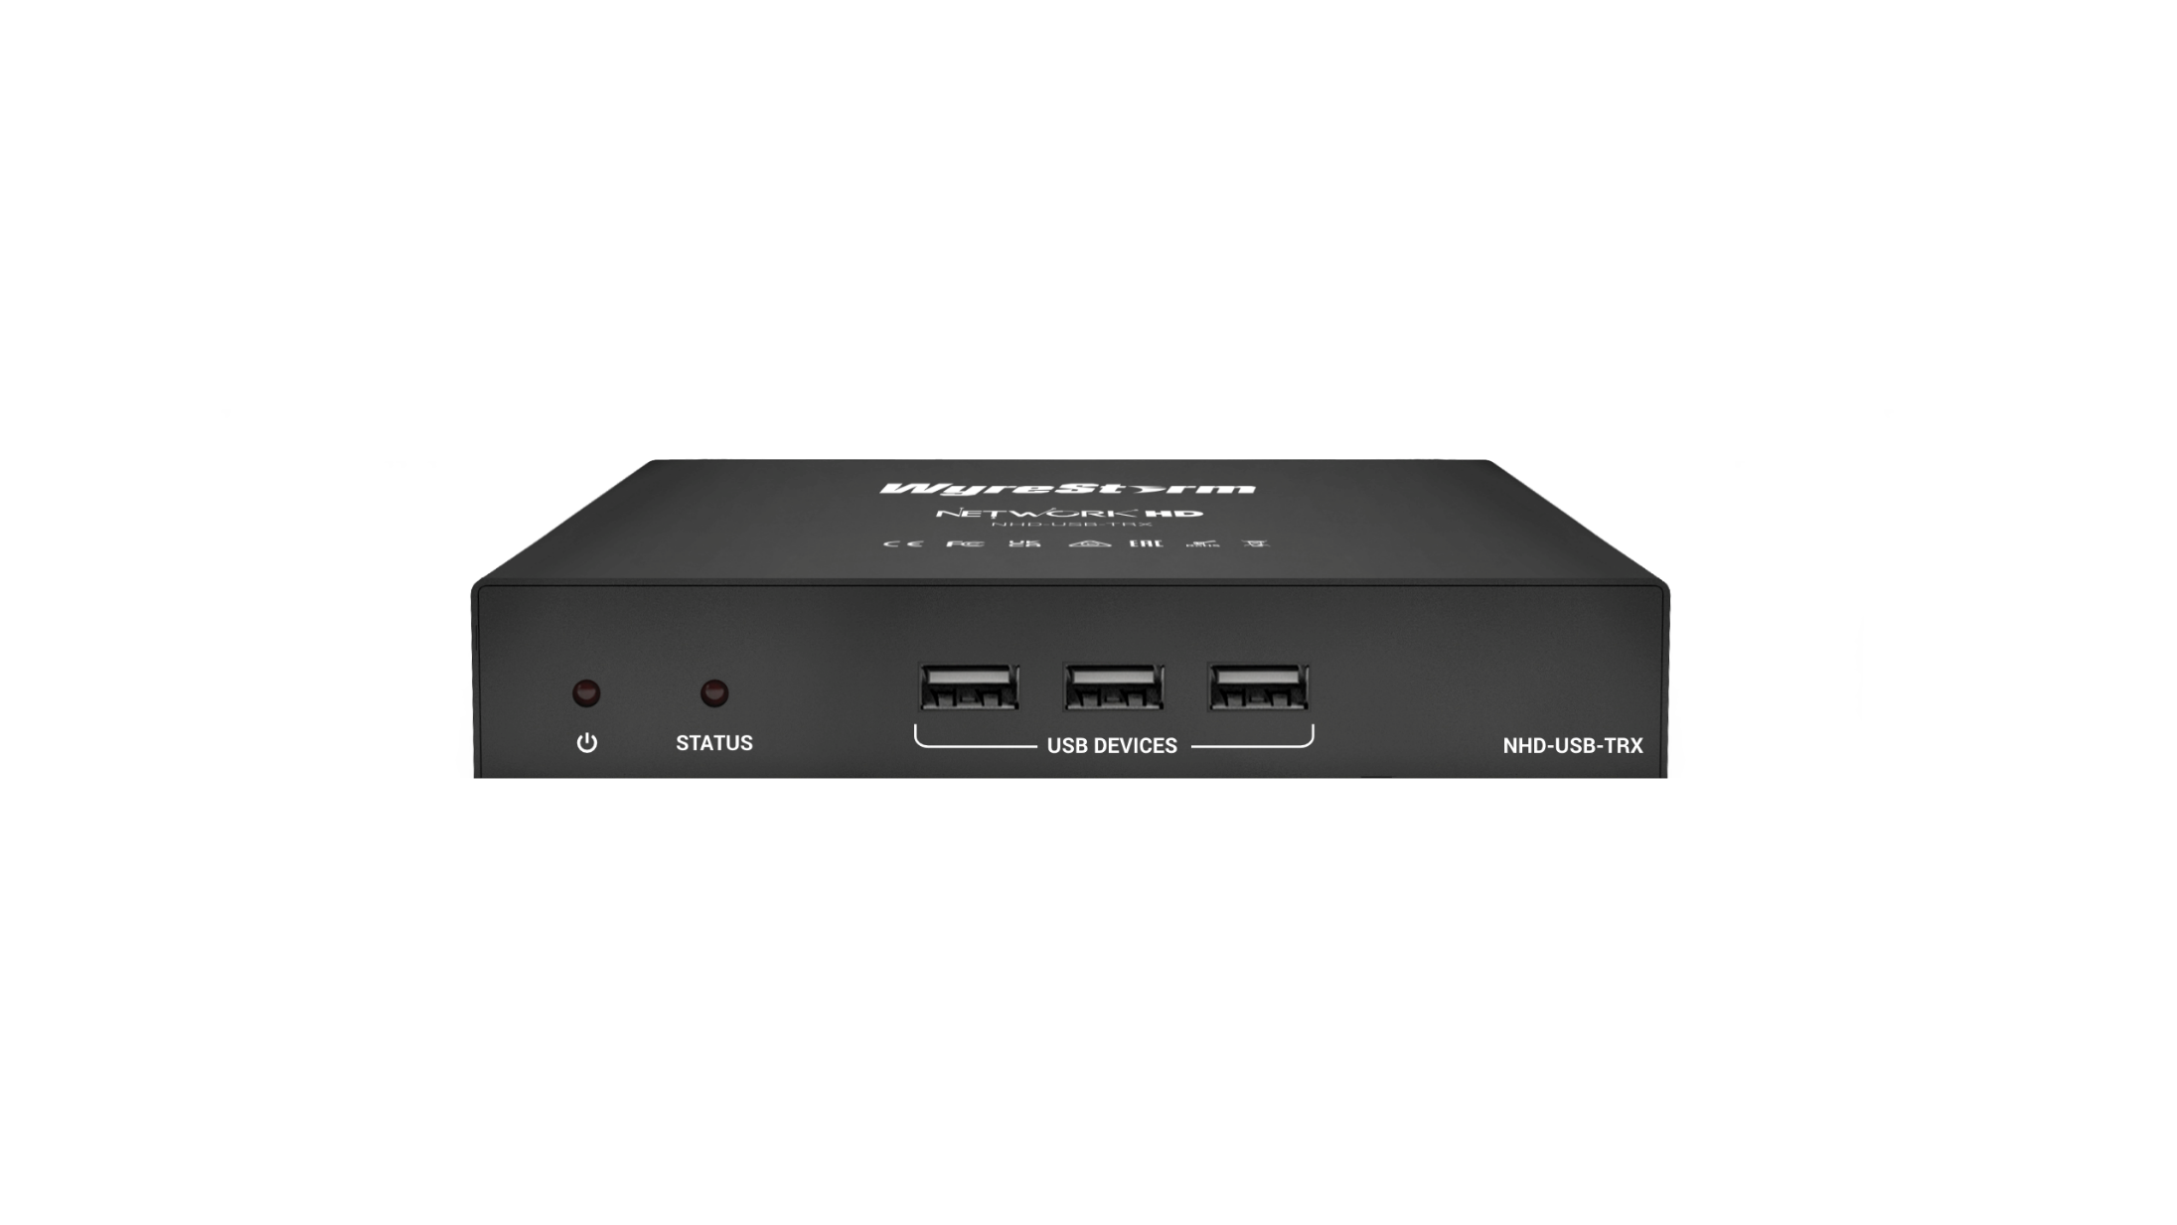

Interface of the Product
USB Devices Connector:
USB3.2 Gen2 on HOST mode
USB2.0 on DEVICE mode
STATUS LED
POWER LED
Rear Panel
DC Connector with Locking Type
Mode Selection DIP Switch
Factory Reset Button
USB Host Connector
LAN Connector (PoE+ Enabled)
LAN (SFP) Connector
Powerful · Reliable · Simple

Slide 5
Specifications & Packing List
Main Specifications
USB Host | 1x USB3.2 Gen2 Type-B, 10Gbps
USB Device | HOST mode: 3x USB3.2 Gen 2 Type-A, 10Gbps Device mode: 3x USB2.0 Type-A, 480Mbps
LAN | 1x RJ45 (PoE+) 1x SFP
Control | DIP Switch NHD-CTL-PRO Console API
Power Supply | 12V 2A DC
What’s in the Box?
1x NHD-USB-TRX
2x Plastic Mounting Brackets
1x Quick Start Guide
NOT in the Box
Power Supply
1G DLC SFP Module
Powerful · Reliable · Simple

Slide 6
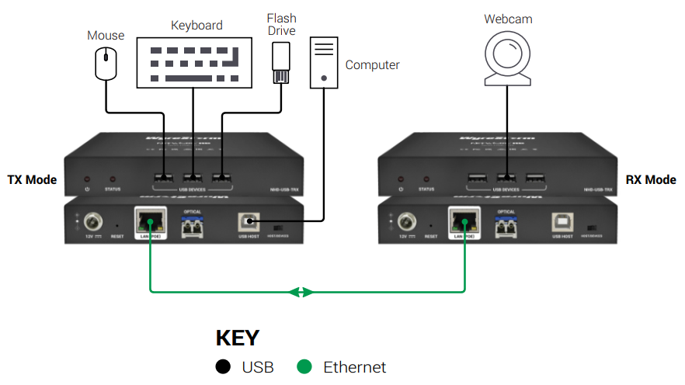
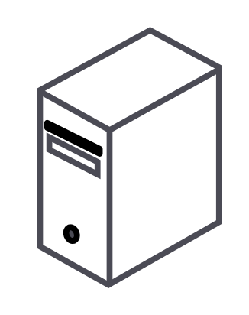
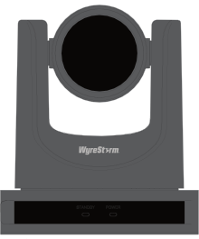
Typical Connection & Applications
Application Scenario 1: Point to Point
No NHD-CTL-PRO required for operation
USB 3.2 Gen2 (up to 10Gbps) for local high-speed connections.
USB2.0 for remote device connectivity.
HOST Mode
DEVICE Mode
Powerful · Reliable · Simple

Slide 7
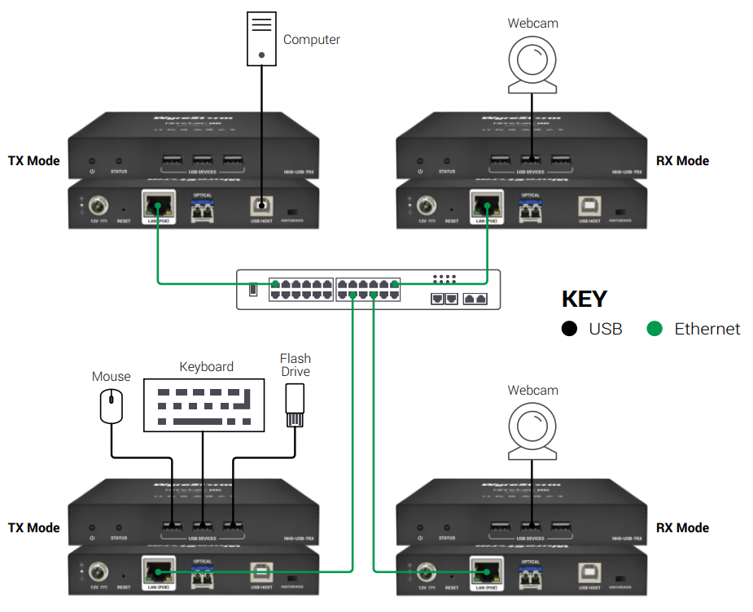
Typical Connection & Applications
Application Scenario 2: Point to Multipoint
One host connecting to multiple devices in different locations.
Managed by NHD-CTL-PRO for centralized control.
USB 3.2 Gen2 (up to 10Gbps) for local high-speed connections.
USB2.0 for remote device connectivity.
HOST Mode
DEVICE Mode
DEVICE Mode
DEVICE Mode
Powerful · Reliable · Simple

Slide 8
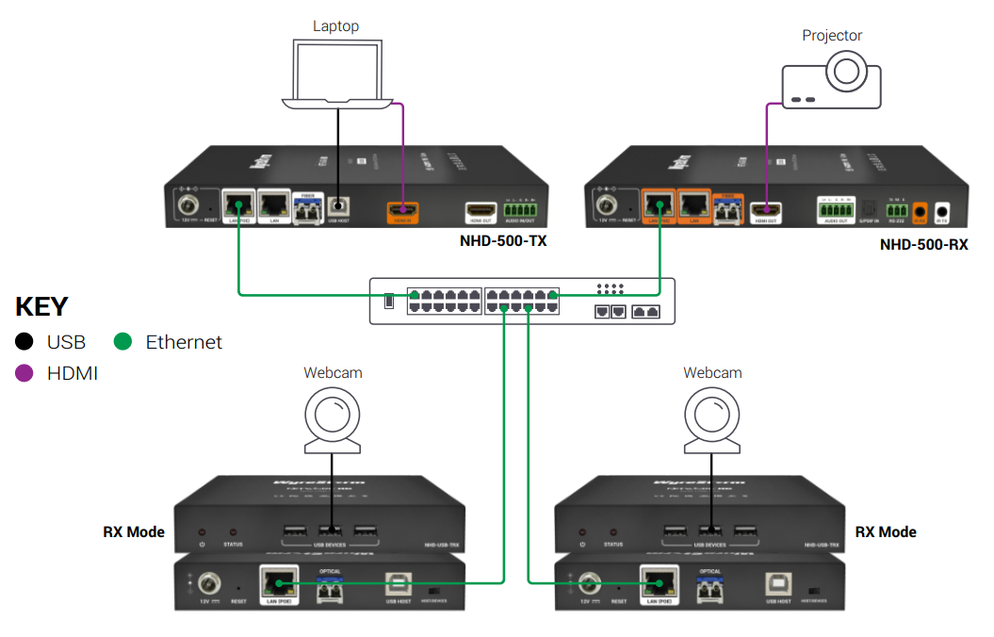
Typical Connection & Applications
Application Scenario 3: Interoperable with NHD-500
One host connecting to multiple devices in different locations.
Acts as a USB-only extension for the NHD-500 ecosystem.
Fully managed by NHD-CTL-PRO for seamless integration.
USB2.0 for remote device connectivity.
DEVICE Mode
DEVICE Mode
Powerful · Reliable · Simple

Slide 9
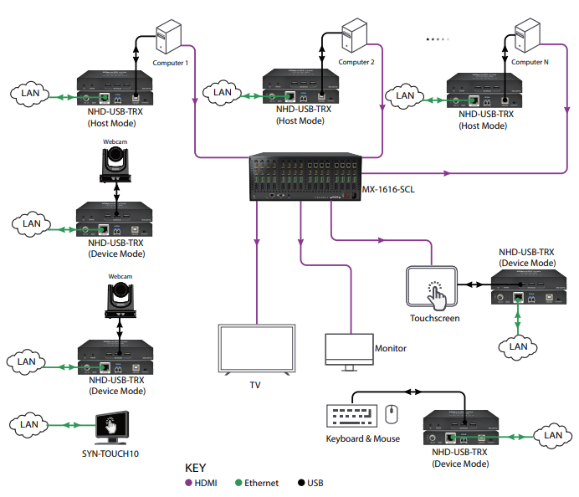
Typical Connection & Applications
Application Scenario 4: USB over IP Solution with Matrix
Each host can connect to multiple devices in different locations.
USB over IP solution offers more wiring flexibility and possibilities in many scenarios.
The routing relationship between hosts and devices can be flexibly adjusted according to the scenario.
Fully managed by SYN-TOUCH10 for seamless integration.
USB2.0 for remote device connectivity.
Powerful · Reliable · Simple

Slide 10
Comparison with Other Competitors
 | WyreStorm NHD-USB-TRX | Icron (ADI) USB 2.0 Ranger 2304PoE
USB 2.0 High Speed | 480Mbps | 480Mbps
USB Local Hub on TX | USB3.2 Gen 2 10Gbps | USB2.0 480Mbps
USB Downstream Ports | 3 | 4
Max. Power Current on USB Ports | 3.0A total shared | 1.5A at each port, 3.5A total
Max. Devices Quantity | 7 | 30
Max. Endpoints Quantity | 21 | Unlimited
Measured Camera Bandwidth | 160Mbps | 160Mbps
USB Hub/Tier Usage | Two Hubs total, one on HOST end, one on DEVICE end | Two Hubs total, one on LEX, one on REX
Working with NHD-500 family | Yes | No
Transceiver | Yes | No
Powerful · Reliable · Simple

Slide 11

Our Advantages
The NHD-USB-TRX delivers a flexible, scalable, and cost-effective solution, ideal for conference rooms, classrooms, and professional environments, ensuring seamless connectivity and efficient performance for all your presentation and conferencing needs.
Our key advantages include:
USB2.0 Over IP: Supports up to 7 USB devices and 21 endpoints for flexible, scalable one-to-many setups.
NHD-500 Compatibility: Seamlessly integrates with the NHD-500 family for smooth system management and easy setup.
Transceiver Flexibility: One SKU for both Transmitter and Receiver, streamlining inventory management and system configuration.
USB Camera Support: Ideal for video conferencing and interactive presentations, with native support for USB cameras.
Cost-Effective: Offers a powerful, affordable solution for professional environments.
Powerful · Reliable · Simple

Slide 12

Quick Installation Guide
To install the presentation device, it simply takes 4 steps below:
Configuring HOST or DEVICE Mode
Use the DIP switch to set the NHD-USB-TRX to either HOST or DEVICE mode.
Connect and Power Up
Connect USB cables, Ethernet cable, and power up the device using either PoE+ or a power adapter.
Configure Routing via NHD-CTL-PRO
Log in to the NHD-CTL-PRO controller.
Set up the routing between TX (transmitter) and RX (receiver).
Optionally, configure the device to work seamlessly with the NHD-500 family endpoints.
IMPORTANT
PoE+ Compatibility
Using a PoE+ (802.3at) capability network switch instead of a PoE (802.3af) only for getting full power for USB devices.
Power Supply Option
When not using PoE+, ensure you use a compatible power adapter capable of supplying at least 2A current to power the device effectively
Powerful · Reliable · Simple

Slide 13

Introduction of Web Configuration Interface
The Web Configuration Interface on NHD-CTL-PRO provides an intuitive platform for managing devices and streamlining workflows.
Key functionalities include:
Firmware Management
Perform simultaneous firmware upgrades for one or multiple NHD-USB-TRX devices, saving time and effort.
Routing Management
Configure routing between NHD-USB-TRX devices on the HOST and DEVICE ends.
Seamlessly integrate and manage routes involving NHD-500 Encoders or Decoders.
Working Mode Configuration
Dynamically switch USB-TRX modes directly via the NHD-CTL-PRO interface, even during runtime.
Powerful · Reliable · Simple

Slide 14

Final Thoughts
Q & A Session
Got questions? Let's dive into a lively Q&A session!
Your curiosity fuels the conversation, so don’t hesitate to ask away.
Powerful · Reliable · Simple

